Slide 1
Concept Maps in Accounting Education © 2021 by Wealthvox,
Color Accounting International, Middlesex University, Accounting Cafe, Peter Frampton, Mark Robilliard, Toby York and others is licensed under Attribution-NonCommercial-NoDerivatives 4.0 International
Notes:
Concept Maps in Accounting Education © 2021 by Wealthvox, Color Accounting International, Middlesex University, Accounting Cafe, Peter Frampton, Mark Robilliard, Toby York and others is licensed under Attribution-NonCommercial-NoDerivatives 4.0 International

Slide 2


Seminar begins at 3pm
Notes:
Concept Maps in Accounting Education © 2021 by Wealthvox, Color Accounting International, Middlesex University, Accounting Cafe, Peter Frampton, Mark Robilliard, Toby York and others is licensed under Attribution-NonCommercial-NoDerivatives 4.0 International

Slide 3
The funding butterfly 40–45 mins
Discussion / break-out 25–30 mins
Reflections / Accounting Cafe 20 mins
Notes:
Concept Maps in Accounting Education © 2021 by Wealthvox, Color Accounting International, Middlesex University, Accounting Cafe, Peter Frampton, Mark Robilliard, Toby York and others is licensed under Attribution-NonCommercial-NoDerivatives 4.0 International

Slide 4


Toby York, Senior Lecturer
Founder, Accounting Cafe
Owns the intellectual property and provides materials and training
The educational methods including the concept map (BaSIS Framework)
Notes:
Concept Maps in Accounting Education © 2021 by Wealthvox, Color Accounting International, Middlesex University, Accounting Cafe, Peter Frampton, Mark Robilliard, Toby York and others is licensed under Attribution-NonCommercial-NoDerivatives 4.0 International

Slide 5
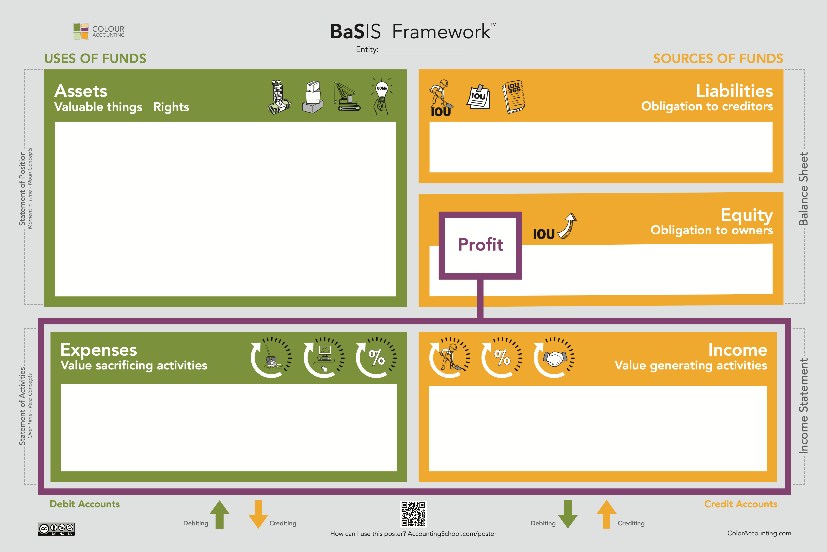
easy@wealthvox.com
Notes:
Concept maps are visual representations of information that show everything in a single view helping students to create a clear mental model, and provide them with the overall meaning, and as John Medina says in Brain Rules “if we don’t know the gist…we are unlikely to pay attention to its details”.
Concept maps work well for all types of students when it is important to understand relationships between different things.
David Ausubel: the single most important factor influencing learning is what the learner already knows. This supports Ausubel’s idea of “meaningful learning”, that is, when the student comprehends the relationship of what is being learned to other knowledge.
Concept maps generally start with higher-level concepts, so help students to create schema for learning. Schema enhance learning by showing students:
The context of what they already know.
How new information fits with what they already know.
How new bits of information fit together.
Medina, J. (2014) Brain Rules. USA: Pear Press
Ausubel, D. (1968) Educational Psychology: A Cognitive View. Canada: Holt, Rinehart & Winston
…but, and I think significantly, we enable students to build the map slowly in their own minds.

Slide 6
Uses of funds
Sources of funds
_Assets
Liabilities_
Equity_
Profit
_Expenses
Income_
Notes:
I use this in PowerPoint all the time – and on sheets of paper.

Slide 7



Where to start…
Notes:
We start with students at the very beginning.
One of the principles of the “Colour Accounting” method is that accounting courses generally do not start at the beginning.
They may start where most accountants think the beginning is, maybe with some definitions of financial statement elements, or perhaps even one of the Conceptual Framework statements.
…but this is not usually the true beginning for most students.
We spend the first few hours of teaching enabling students to explore and reflect on the underlying philosophy of accounting. And in my experience, these are some of the most enjoyable conversations you can have as a teacher.
We won’t go through the whole process, but it I’ll show you some of the steps…

Slide 8
Notes:
We use a conversation as an anchor to emphasise the importance of “POINT OF VIEW” which is so fundamental to language and understanding.
Pineapples are peppered throughout my teaching materials and in seminars students will often hear me say “pineapples” whenever there is entity confusion.

Slide 9
The funding butterfly
Notes:
Concept Maps in Accounting Education © 2021 by Wealthvox, Color Accounting International, Middlesex University, Accounting Cafe, Peter Frampton, Mark Robilliard, Toby York and others is licensed under Attribution-NonCommercial-NoDerivatives 4.0 International

Slide 10


{ Choose a name } Limited
Notes:
The spirit of this educational method is joyful…occasionally whimsical…always engaging and conversational.
At Middlesex this is done during induction in a 4–5 hour session.
This is the “funding butterfly”. It’s not explained to students in any detail –– they discover it through conversation and thought.
A speeded-up version of the conversation….
Teacher: What type of business is this?
Student: A supermarket.
Teacher: What can you see in the picture?
Student: Fruit, bread, shelves, a trolley.
Teacher: What types of things are these?
Student: [Maybe with some guidance] Assets.
We then have a long conversation about assets: usually around 2 hours.
For example, students are asked to provide examples of assets that this business might own.
It invariably leads to sophisticated and philosophical questions. Typically covering topics such as intangible assets, goodwill, and staff as assets.
We make a vital distinction here: “assets” versus “recognised assets”.
This is often an exciting, challenging and rewarding session. I always learn something from students during these conversations that hones my own thinking and improves my teaching.

Slide 11

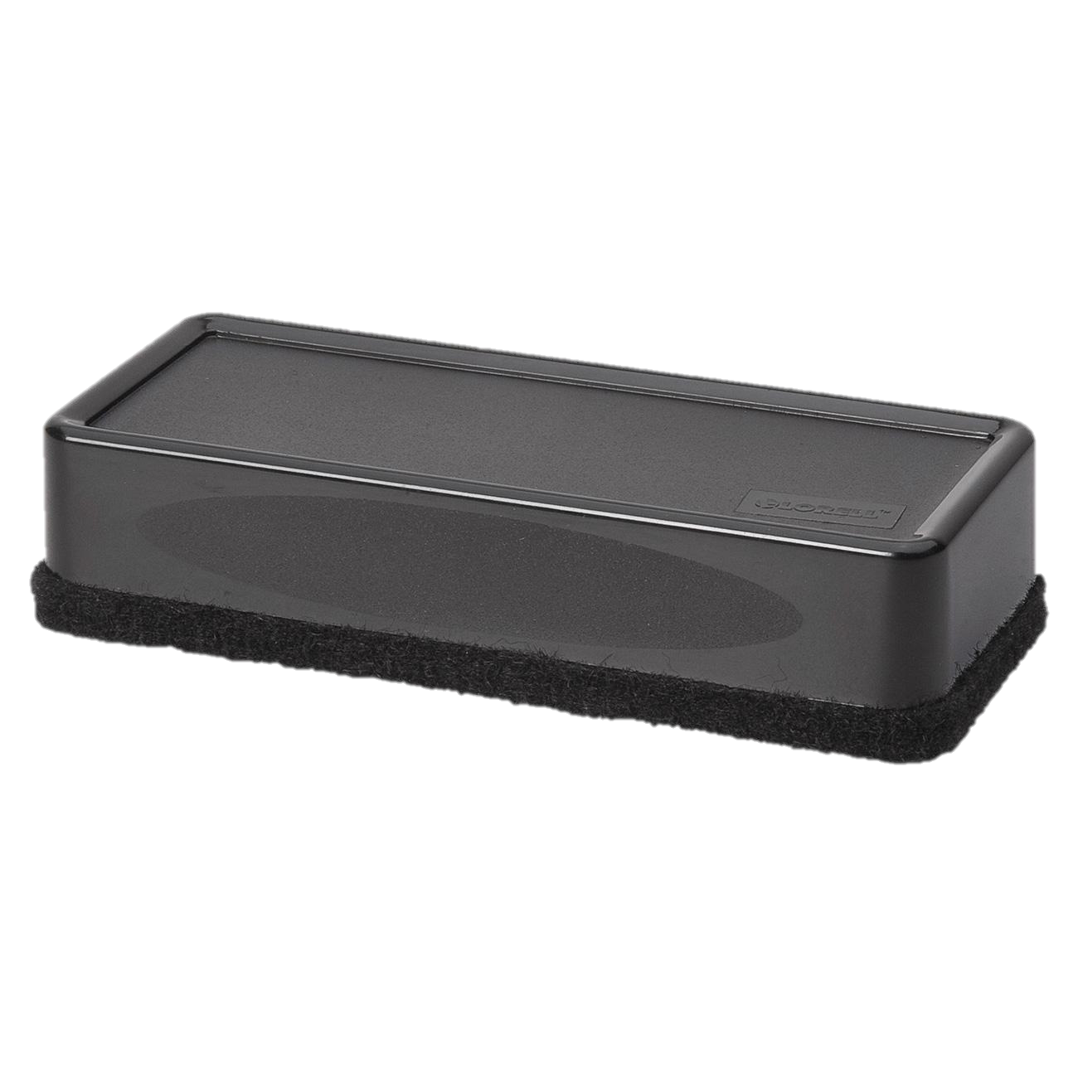
{ Choose a name } Limited
Notes:
Another aspect of this method is that, before lockdown anyway, it was not technology led.
That’s not to say that it can’t be used with technology – but the approach with students is direct and tactile.
I will come back to teaching materials later on.
This slide was drawn in real time with OneNote and presented on Zoom.

Slide 12

{ Choose a name } Limited
Notes:
Another aspect of this method is that, before lockdown anyway, it was not technology led.
That’s not to say that it can’t be used with technology – but the approach with students is direct and tactile.
I will come back to teaching materials later on.
This slide was drawn in real time with OneNote and presented on Zoom.

Slide 13
Uses of funds
{ Choose a name } Limited
Sources of funds
Assets
Liabilities
30,000
50,000
=
+
Equity
20,000
Notes:
Building the concept map with students
The conversation is developed through questions.
Let’s say the assets are worth £50,000 –– how might a business fund its assets?

Slide 14
My Supermarket Limited
Uses of funds
Sources of funds
Assets
Liabilities
£30,000
£50,000
=
+
Equity
£20,000
Assets
=
Liabilities
+
Equity
Assets
–
Liabilities
=
Equity
padlet.com/MDX_Toby/questions
Notes:
Leading on nicely to the accounting equation.
I’ve summarised a two hour conversation.
There are lots of possibilities for adjunct activities:
–– the importance of the £ sign – money versus monetisation
–– what happens to the funding side of the equation if the value of assets changes?
–– what are the different nature of these elements? Same values / different natures.
–– what are the differences between equity and debt?
So the concept map is slowly coming into view but we have only spoken about “duality” not double entry.

Slide 15
A rabble of butterflies
Lender
Loan receivable
Liabilities
Entity
Equity
Liabilities
Assets
Equity
Investor
Investment in equity
Liabilities
Equity
Notes:
This is one of my favourite slides –– I use time and again in my lectures.
It is such a helpful reminder to students that entities exist in relation to other entities.
It also clears up a lot of confusion for students about the nature of equity –– and for banking and finance students the nature of a bank’s balance sheet: loans are assets and deposits are liabilities.
It emphasises perhaps the single biggest problems for students of accounting: point of view.
I also think that the IASB should have a copy of this stuck to the wall––probably for another seminar but their definition of equity has the whiff of “entity confusion”.

Slide 16
easy@wealthvox.com
t.york@mdx.ac.uk
bit.ly/MDXconceptmap
accountingcafe.org
LinkedIn
LinkedIn
Concept Maps in Accounting Education © 2021 by Wealthvox, Color Accounting International, Middlesex University, Accounting Cafe, Peter Frampton, Mark Robilliard, Toby York and others is licensed under Attribution-NonCommercial-NoDerivatives 4.0 International
Notes:
Concept Maps in Accounting Education © 2021 by Wealthvox, Color Accounting International, Middlesex University, Accounting Cafe, Peter Frampton, Mark Robilliard, Toby York and others is licensed under Attribution-NonCommercial-NoDerivatives 4.0 International
If you would like sample materials there are free resources on the Colour Accounting educators’ website. Please contact Wealthvox directly for a sample pack.
If you want to contribute to Accounting Cafe or start a conversation about accounting education, please join the community.

